Slide 1
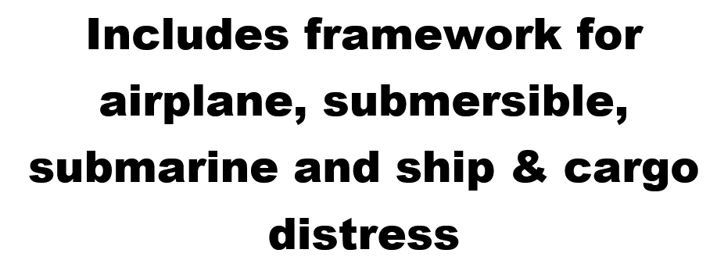
UWSAR – Regulatory Framework for the IOR

Slide 2
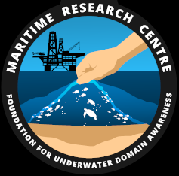
ABOUT PS STATION (MRC)
The prime vision of the MRC is to be a nodal research center on maritime issues and contribute as a technology driven think tank on the broader Underwater Domain Awareness (UDA) framework (discussed at the end) in the Indian Ocean Region (IOR). Towards that it will formulate specific research areas that can generate significant local inputs in the IOR both scientific and strategic to guide technology development, business environment and regulatory formulations.

Slide 3
CONTENTS
Methods to track last known position and organizations involved
Need of conducting bathymetric surveying and IOBC project
Case study of AF 447 search operation
Case study of AF 447 rescue operation
SAR mission organization in India
MRCCs and coordination among IOR countries for SAR operations in the region

Slide 4
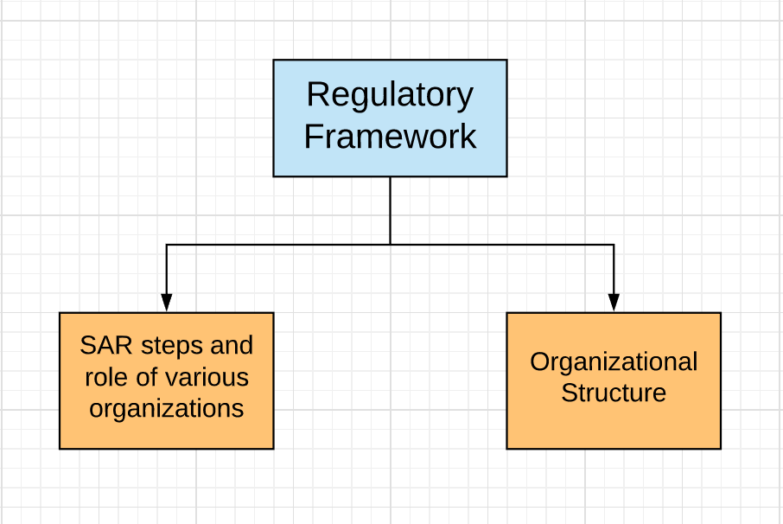

Slide 5
STEPS INVOLVED
To identify the distressed object
Locating the last known position of distressed object
Surveying the sea bed ( optional )
Send a ROV / any other search vehicle to the location for the distressed object ( search operation )
Salvage / recovery operation of the distressed object

Slide 6
Locating a Distressed Airplane
Can be done using radar systems ( most commonly used, not full proof though ), GPS and Satellite-tracking system ( upcoming system ).
For India and for the Indian Ocean Region the Air Traffic Control (ATC) service of the Airports Authority of India provide radar navigation for planes.
The satellite-tracking system is operated by a trio of companies: Aireon, SITAONAIR, and FlightAware. It uses a constellation of 72 communication satellites operated by US firm Iridium (whose main business is selling satellite phones connected to its network). The flights will be tracked using an industry-wide standard known as “automatic dependent surveillance – broadcast” or ADS-B, which usually shares data on flight location via ground-based receivers.

Slide 7
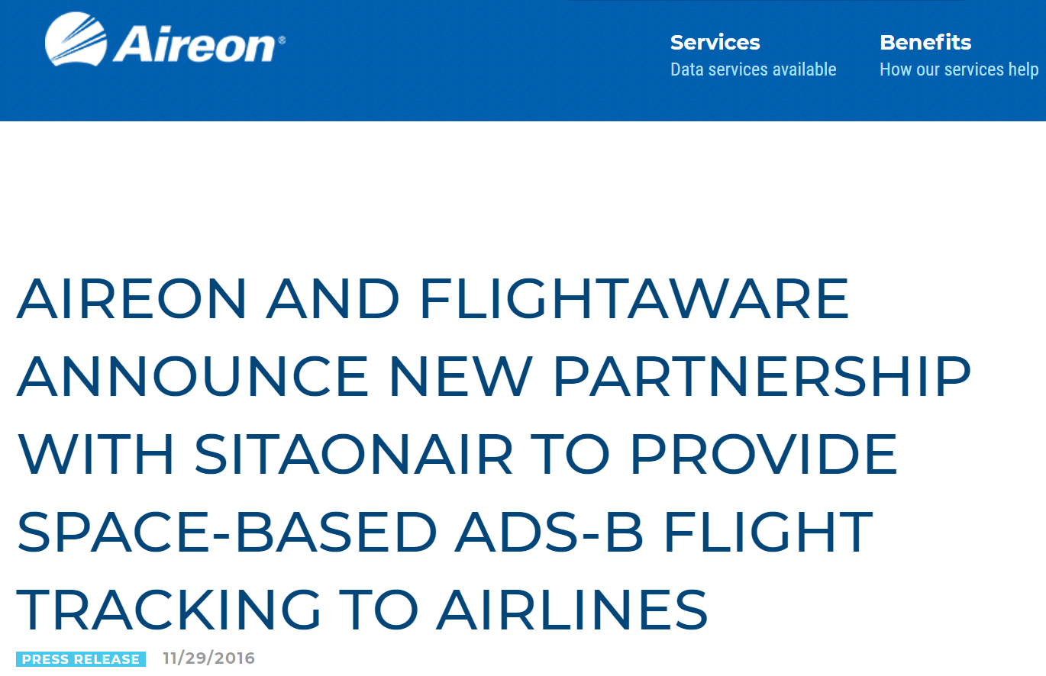
Figure 1: Press release by AIREON Ref: https://aireon.com/2016/11/29/aireon-flightaware-announce-new-partnership-sitaonair-provide-space-based-ads-b-flight-tracking-airlines/

Slide 8
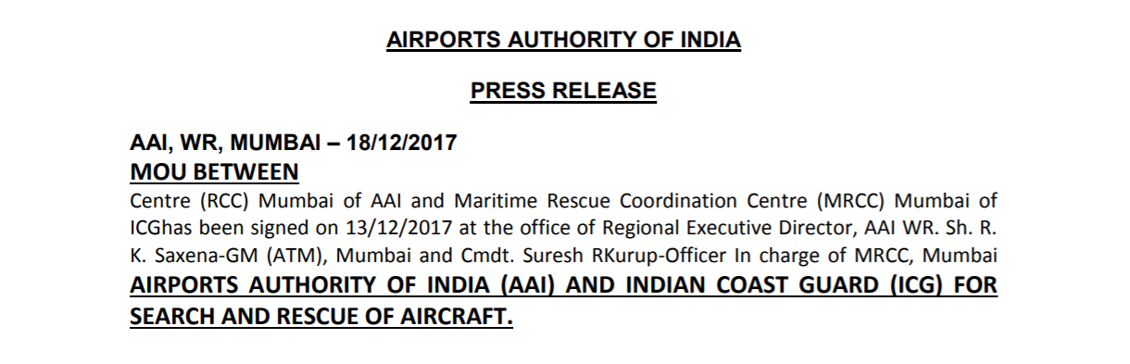
Figure 2: Press release by AAI Ref : https://www.aai.aero/sites/default/files/press_release_news/MOU%20WITH%20COAST%20Guard.pdf

Slide 9
Locating a distressed Ship/ Cargo
Done mostly with the help of Automatic Identification System (AIS) data → as per regulation 19 of SOLAS Chapter V.
In IOR → Information Management and Analysis Centre (IMAC), Gurgoan uses this data to track ships and non – military submersibles
IMAC is a joint initiative of the navy, coast guard and the Bharat Electronics Ltd → hence no need of MoU here

Slide 10
Locating a distressed non – military submersible
Again AIS data can and is generally used which can be provided by the Information Management and Analysis Centre (IMAC), Gurgoan
Also the coast guard must form guidelines for compulsory installation of Transmitter Bouy or an emergency pinger in such a submersible as well as sonar sensors equipped to search for transponder signals from these devices ( this can help in the later part of this process )

Slide 11
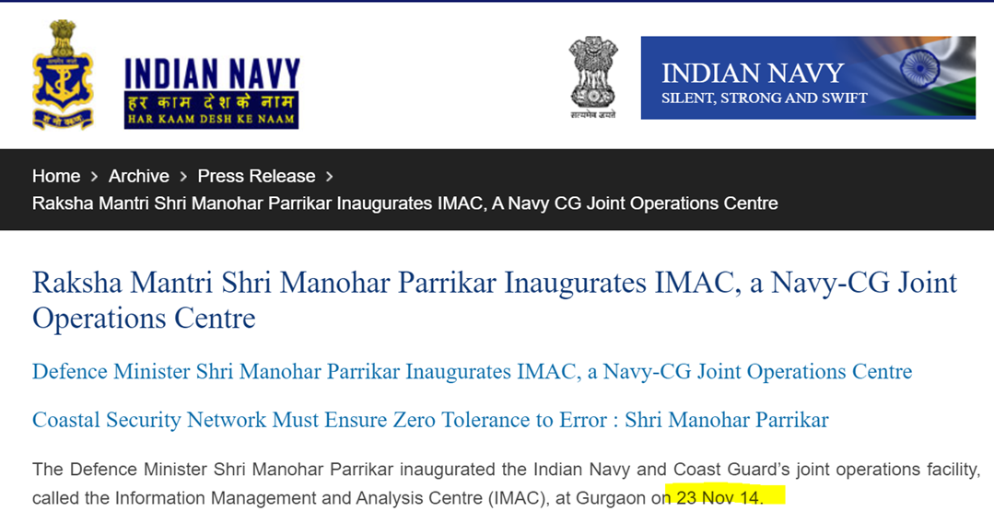
Locating a distressed military submersible / submarine
Here you can’t fit a Transmitter Bouy or an emergency pinger because the exact location of military submersibles have to remain confidential with the navy, so reliance on AIS increases
Figure 3: Press release by Navy ( IMAC inauguration)
Ref:https://www.indiannavy.nic.in/content/raksha-mantri-shri-manohar-parrikar-inaugurates-imac-navy-cg-joint-operations-centre

Slide 12
SURVEYING
Before beginning the search process it’s essential to ensure that we are well aware of the submarine topography of the area on which the search and rescue operation is to be carried out thereby making the search process safe and effective.
So typically this is done only in cases where the search area is estimated to have irregular underwater terrain and varies in dept at different locations

Slide 13
BATHYMETRIC SURVEY
The term bathymetry originally referred to the ocean’s depth relative to sea level, although it has now come to mean submarine topography or the shape and depths of underwater terrain. In the same way that topographic maps represent the three dimensional features of overland terrain, bathymetric maps illustrate the land that lies underwater. Variations in sea-floor relief may be depicted by colour or contour lines called depth contours or isobaths.
This process that involves scanning the ocean floor with multi-beam sonar takes a lot of time.

Slide 14
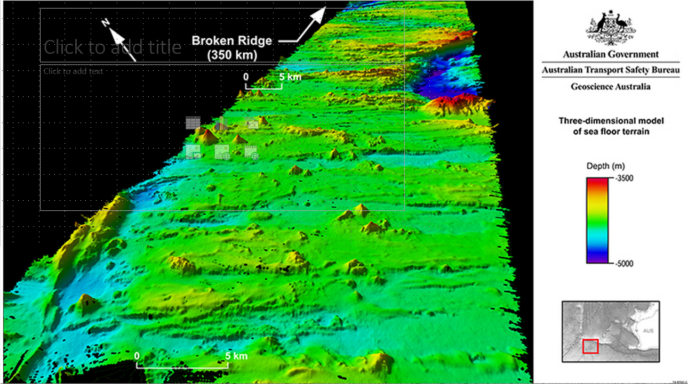
Figure 4: From bathymetric survey results conducted during recovery operation of MH 370
Ref: SURVEYING AND ITS ROLE IN THE SEARCH FOR A MISSING AIRPLANE – SM Ndlovu (2018)

Slide 15
BATHYMETRIC SURVEY IN THE IOR
No ocean-wide map of the Indian Ocean has been produced since the 2003 map based on the work of Dr. Bob Fisher and D.r Andrew Goodwillie. No ocean-wide map has ever been produced using multibeam (as opposed to single beam) echosounders. No ocean-wide map has ever been produced incorporating long-wavelength information from satellite altimetry. Yet some of these data exist for the area. This means that the Indian Ocean is not as well mapped as it can be and should be.
The General Bathymetric Chart of the Oceans (GEBCO) is working to map IOR floor under its Indian Ocean Bathymetric Compilation (IOBC) project.

Slide 16
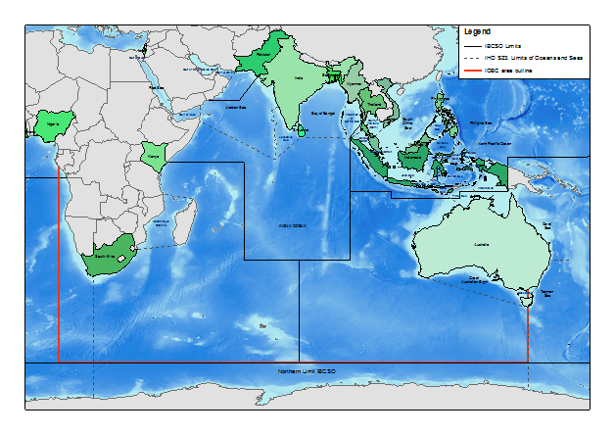
Figure 5: General limits of the Indian Ocean Bathymetric Compilation project
Ref: http://ccom.unh.edu/indian-ocean-bathymetric-compilation-project

Slide 17
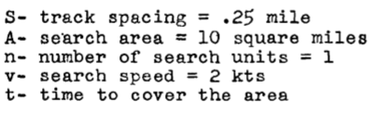
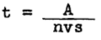
SENDING SEARCH VEHICLE TO THE DISTRESS SCENE ( Choice Criteria )
Fast decent
High endurance
Speed of search
Navigation
Visibility

Slide 18
AF 447 – A SUMMARY OF SEARCH OPERATION
The search process that was carried for over two years took four phases to complete.
Phase 1 → The acoustic searches were carried out aimed at detecting the acoustic signals transmitted by the Underwater Locator Beacons (ULB) on the recorders. A vast zone was swept by Towed Pinger Locator (TPL) along the airplane’s projected trajectory
Phase 2 → IFREMER deep towed side-scan sonar was used. Although this search turned out to be unsuccessful, this phase enabled to carry out a complete bathymetric survey of the target zone

Slide 19
Phase 3 → Consisted of two search periods onsite: from 2 to 25 April 2010 and from 3 to 24 May 2010. The ORION deep towed sonar and the three REMUS 6000 autonomous underwater vehicles (AUV) operated by the American Woods Hole Oceanographic Institution (WHOI) in a limited area of target zone .
Phase 4 → During this phase, the REMUS 6000 AUVs were again used for the search. They were operated by WHOI . The operation was carried out near the centre of the target zone after a study (the Metron Study) showed higher probability of finding the distressed vehicle in that zone.

Slide 20
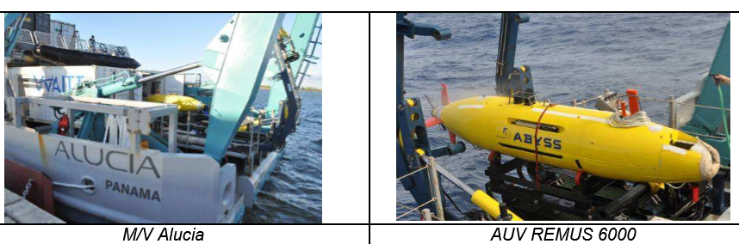
Figure 6: Phase 4 search equipment of the AF447 search operation
Ref: AF447 Underwater Search and Recovery Operations A Shared Government-Industry Process - Olivier Ferrante (BEA), Michael Kutzleb (Phoenix International) and Michael Purcell (WHOI) - 2011

Slide 21
USING RECOVERY VEHICLE TO BRING THE DISTRESSED VECHILE TO THE SEA SURFACE (Choice Criteria)
Speed ( affected by payload and the drift )
Load lifting capacity
AF 447 case →They took into consideration the difficult environment and the remoteness of the accident site and choice was based on ship storage capacity, ship and ROV lifting capacity, ROV maximum operating depth as well as ROV maneuvering capabilities.

Slide 22
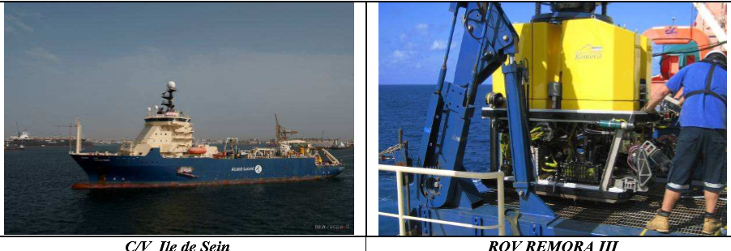
Final choice - cable vessel C/V Ile de Sein operated by Alcatel-Lucent and Louis-Dreyfus Armateurs (LDA), equipped with the REMORA III Remotely Operated Vehicle (ROV) from Phoenix International that can operate at maximum depth of 6000 meters.
Figure 7: Phase 5 recovery equipment of the AF447 search operation
Ref: AF447 Underwater Search and Recovery Operations A Shared Government-Industry Process - Olivier Ferrante (BEA), Michael Kutzleb (Phoenix International) and Michael Purcell (WHOI) - 2011

Slide 23
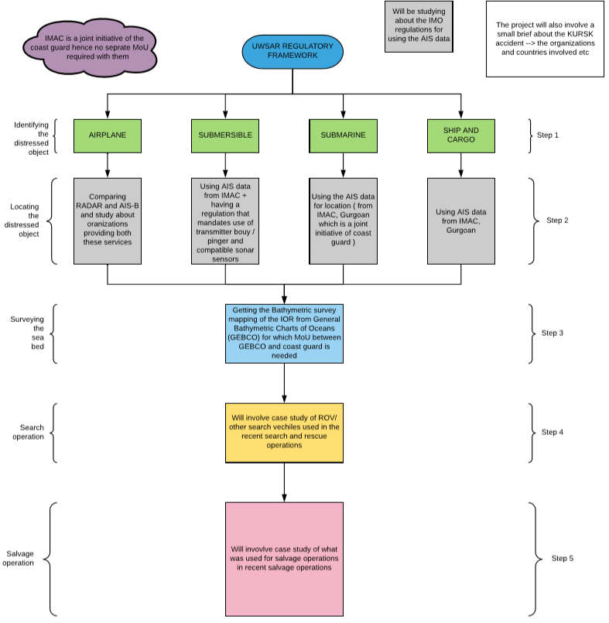
FLOWCHART
PART 1

Slide 24
SAR MISSION ORGANIZATION
SAR Coordinator
SAR Mission Coordinator
On Scene Coordinator
*Aircraft Coordinator ( not always present though )
Search and Rescue Units

Slide 25
SAR COORDINATOR (SC)
The SAR Coordinator (SC) is the top level SAR manager who has overall responsibility for establishing, staffing, equipping and managing SAR system with thorough coordination and using the available SAR resources.
The SAR Coordinator should ensure that the MRCC/MRSC/MRSSC is familiar with the capabilities of all the facilities available for SAR in its SRR.

Slide 26
SAR MISSION COORDINATOR (SMC)
An SMC should be designated for each specific SAR operation. Every mission is conducted under guidance of SMC and for the duration of that particular mission.
While the overall responsibility of the mission is with the SAR Coordinator (SC), the SMC plans, coordinates including transit of SAR facilities to the scene and controls SAR missions with the available resources for the time assigned till conclusion of each mission.

Slide 27
ON SCENE COORDINATOR (OSC)
The On Scene Coordinator (OSC) is designated by the SMC when two or more SAR units are working together on the same mission to enable better coordination of the activities amongst the participating units on the scene.
An OSC need not be a SRU.

Slide 28
AIRCRAFT COORDINATOR (ACO)
When two or more SAR facilities including aircraft are working together on the same mission, SMC designates one unit as Aircraft Coordinator (ACO) for coordinating air traffic, in addition to the OSC.
Preferably, OSC and ACO should be different units. If it is not practicable, then OSC itself acts as ACO.
The primary concern of ACO is the flight safety of SAR aircraft.

Slide 29
SEARCH AND RESCUE UNITS (SRUs)
The Search and Rescue Units (SRUs) are used as a resource for performing search, rescue or similar operations.
It is composed of trained personnel proficient in SAR skills and equipment suitable for the expeditious and efficient conduct of the operation.
In Indian context, the Indian Coast Guard assets are used as the primary SRUs.
In addition to the SRUs, resources for SAR operations can be demanded by the SAR coordinator from the resource agencies.

Slide 30
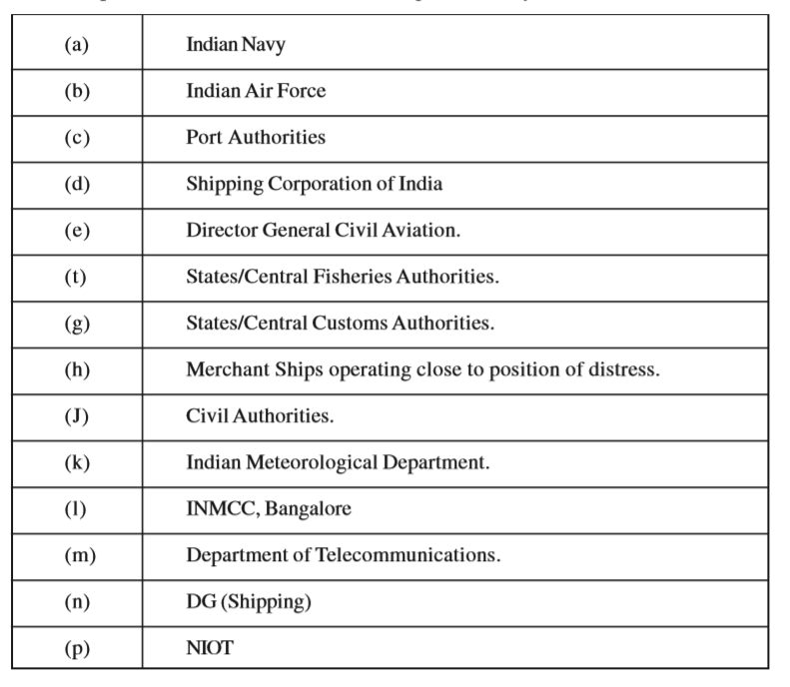
Table 1: List of Resource Agencies
Ref:https://www.indiancoastguard.gov.in/WriteReadData/bookpdf/201603180305291474292NMSAR_MANUA-2010.pdf

Slide 31
MARITIME RESCUE COORDINATION CENTRE IN ISRR
The ISRR is divided into three areas with Maritime Rescue Coordination Centres (MRCCs) located at Mumbai, Chennai and Port Blair.
There are 10 Maritime Rescue Sub Centres (MRSCs) and 3 Maritime Rescue Sub Sub Centres (MRSSCs) operating under these MRCCs.
The Maritime Rescue Coordination Centre (MRCC) is a facility responsible for promoting efficient organization of SAR services, and for coordinating the conduct of SAR operation within the SRR. The MRCC only coordinates and does not necessarily provide SAR facilities in the applicable SRR.

Slide 32
In order to enable MRCCs exercise direct and effective control over SAR facilities in an area within its SRR, Maritime Rescue Sub Centres (MRSC) and Maritime Rescue Sub Sub Centres (MRSSC) are established.
The SRR of neighboring countries namely Pakistan, Maldives, Sri Lanka, Seychelles, Mauritius, Indonesia, Malaysia, Myanmar and Bangladesh share the boundary with Indian SRR. These SRRs are established in cooperation with the neighboring nations which are internationally recognised.

Slide 33
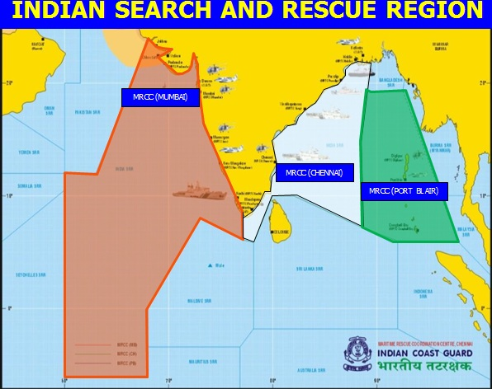
Figure 8: The Indian Search and Rescue Region
Ref: https://www.indiancoastguard.gov.in/content/447_3_NMSARCA.aspx

Slide 34
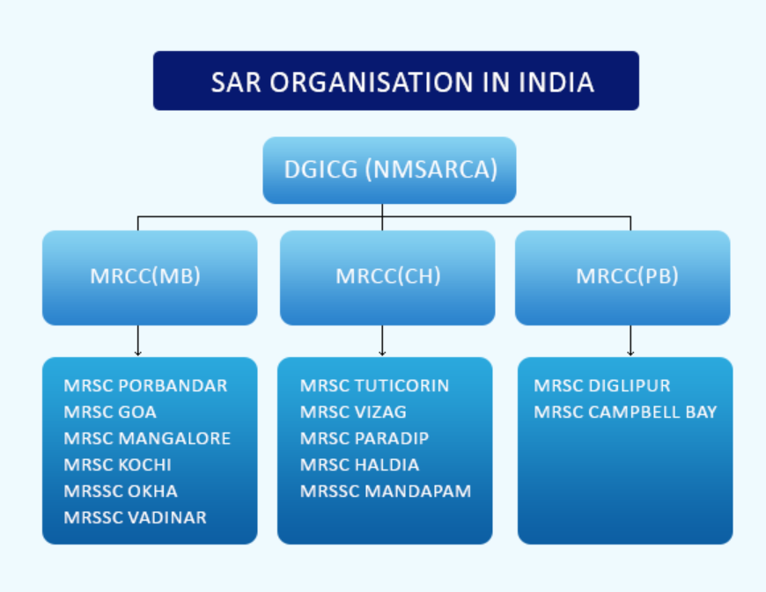
Flowchart 1: SAR organization in India
Ref:https://www.indiancoastguard.gov.in/content/1680_3_SAROrganisation.aspx

Slide 35
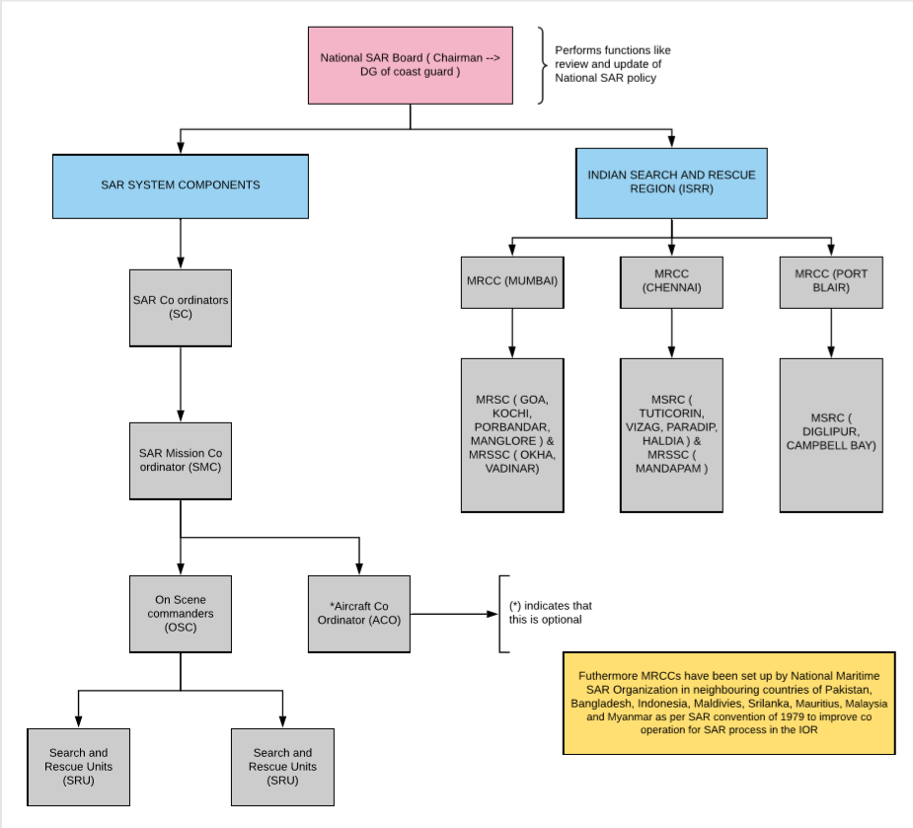
FLOWCHART
PART 2

Slide 36
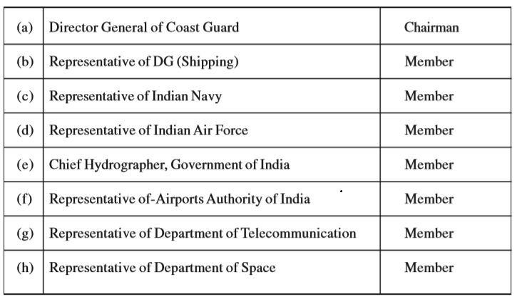
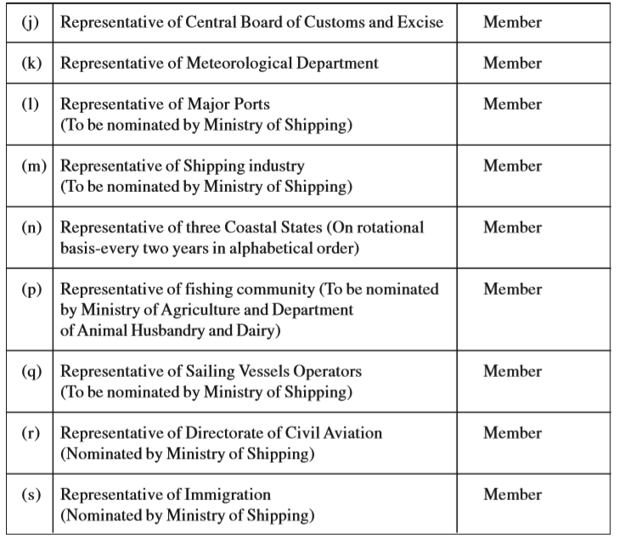
Table 2: The National SAR Board
Ref:https://www.indiancoastguard.gov.in/WriteReadData/bookpdf/201603180305291474292NMSAR_MANUA-2010.pdf

Slide 37
REFERENCES
[1] National maritime search and rescue manual published by the National Maritime Search and Rescue Board → https://www.indiancoastguard.gov.in/WriteReadData/bookpdf/201603180305291474292NMSAR_MANUA-2010.pdf
[2] IAMSAR manual guidelines as per the International Maritime Organization→http://www.imo.org/en/OurWork/Safety/RadioCommunicationsAndSearchAndRescue/SearchAndRescue/Pages/IAMSARManual.aspx
[3] International convention for Maritime Search and Rescue →http://www.imo.org/en/About/Conventions/ListOfConventions/Pages/International-Convention-on-Maritime-Search-and-Rescue-(SAR).aspx
[4] https://www.indiancoastguard.gov.in/content/329_3_SearchAndRescue.aspx
[5] P Howland - IEE Proceedings-Radar, Sonar and Navigation, 2005 - ieeexplore.ieee.org →https://ieeexplore.ieee.org/abstract/document/1459144/
[6] E Griffith, C Hudson, TL Mosher - Uninterruptable ADS-B system for aircraft tracking →https://patents.google.com/patent/US6952631B2/en

Slide 38
[7] Regulation 19 of SOLAS ChapterV →http://www.imo.org/en/OurWork/Safety/Navigation/Pages/AIS.aspx
[8] NMSARCA operation →https://www.indiancoastguard.gov.in/content/447_3_NMSARCA.aspx
[9] MoU with Coast Guard →https://www.aai.aero/sites/default/files/press_release_news/MOU%20WITH%20COAST%20Guard.pdf
[10] https://aireon.com/2016/11/29/aireon-flightaware-announce-new-partnership-sitaonair-provide-space-based-ads-b-flight-tracking-airlines/
[11] Indian Ocean Bathymetric Compilation by GEBCO →http://ccom.unh.edu/indian-ocean-bathymetric-compilation-project
[12] Marlyna Maros1 and Sharifah Nadia Syed Nasharudin - Analysis of Interaction and Institutional Power Relations in MH370 Press Conferences
[13] Olivier Ferrante (BEA), Michael Kutzleb (Phoenix International) and Michael Purcell (WHOI) - AF447 Underwater Search and Recovery Operations A Shared Government-Industry Process
[14] Ingar Amundsen, Bjørn Lind, Ole Reistad, Knut Gussgaard, Mikhail Iosjpe and Morten Sickel – The Kursk Accident

Slide 39

Presentation by-
Tanay Kumar
ID: 2018A8PS0574H

